Slide 1
How does a person’s salary compare to their years of experience? (PT.1)
By: Sarah

Slide 2


% of min years of experience
0-5 min years of experience = 390 people
A majority of the population is in this category
6-10 min years of experience = 51 people
11-17 min years of experience = 17 people
17-20 min years of experience = 1 person

Slide 3
range of salary based on min years of experience
The category for a minimum of 17-20 years of experience shows the lowest median.
While the median is the highest in the 11-17 category, it also has the largest range.
Those who have a minimum of 0-5 years of experience earn a higher salary than those who have a minimum of 6-10.

Slide 4
data

Slide 5
code - pie chart

Slide 6
code - box plot

Slide 7
conclusion
No need to stay in one place for too long.

Slide 8
How is an individual’s salary affected by the years of experience
Sherine

Slide 9
Agenda
Compare an individual’s Salary with a bar graph showing the average of salaries vs the years of experience using data
Line graph of the top 3 Functional Area with that will show how it changes based on years of experience

Slide 10

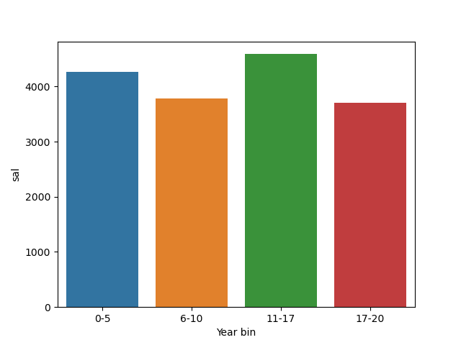

0-5 yrs little above 4,000 6-10 yrs slightly decrease 11-17 yrs highest amount for experience 17-20 drops slightly lower then 6-10yrs of experience

Slide 11

Code:
import seaborn as sns
order=['0-5','6-10','11-17','17-20']
GP= df.set_index('Year bin').groupby ("Year bin").mean()['sal'].reset_index()
GP
sns.barplot(x= 'Year bin', data =GP,order = order,y = "sal")
plt.savefig("bar chart")

Slide 12
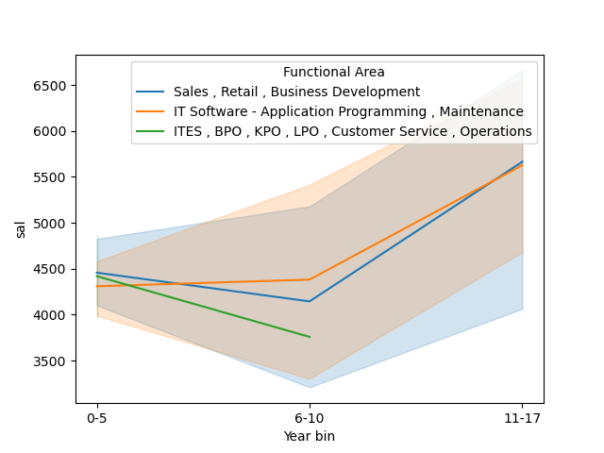
Top 3 Functional Areas and how much they make with so many years of experience

Slide 13
Code for Line graph
DF=DF.loc[ DF['Functional Area'].str.contains('IT Software - Application Programming , Maintenance')| DF['Functional Area'].str.contains('Sales , Retail , Business Development')|DF['Functional Area'].str.contains('ITES , BPO , KPO , LPO , Customer Service , Operations')]
DF
sns.lineplot(data=DF, x="Year bin", y= "sal",hue='Functional Area')
plt.savefig("line chart")

Slide 14


Summary
The over all average salary is more when workers start careers, but salary tends to decrease after a few years then increases slightly then decreases with the most experience.
When data is narrowed down to the top 3 Functional Area, salary increases with years of experience in these targeted careers.

Slide 15
Thank you

Slide 16
Salaries Based on Industry
Comparing salaries between 6 diverse careers

Slide 17
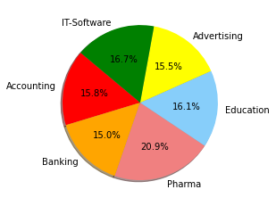
Average Salary per Field
Acounting -$4.022.00
Banking - $3,825.00
Pharma - $5,319.00
Education - $4,093.00
Advertising - $3,935.00
IT-Software - $4,260

Slide 18
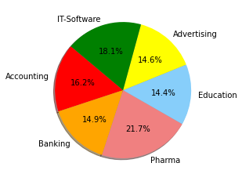
Median Salaries by Field
Field | Salary
Accounting | $3,956.00
Banking | $3,655.00
Pharma | $5,314.00
Education | $3,523.00
Advertising | $3,579.50
IT-Software | $4,434.00

Slide 19
IT-Software is by far the largest industry and accounts for over three fourths the job market

Slide 20
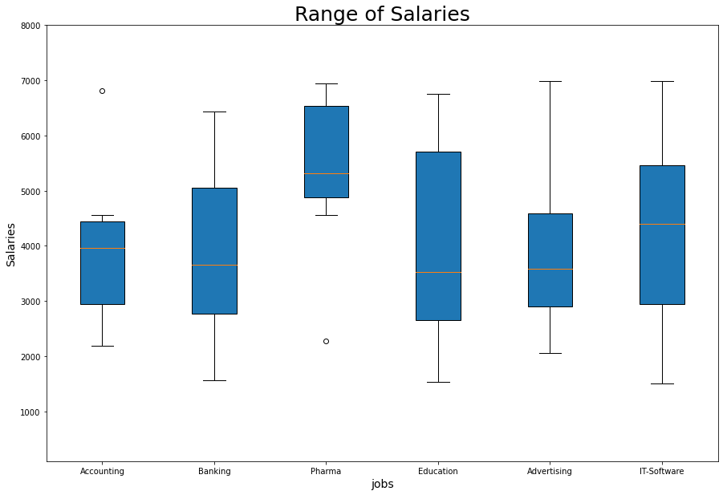
Side by Side Comparison of Ranges
Education has the largest range of salary
Accounting has the smallest range
Beside Pharma the median salary is very similar
Class | Group 1 | Group 2
Class 1 | 82 | 95
Class 2 | 76 | 88
Class 3 | 84 | 90

Slide 21
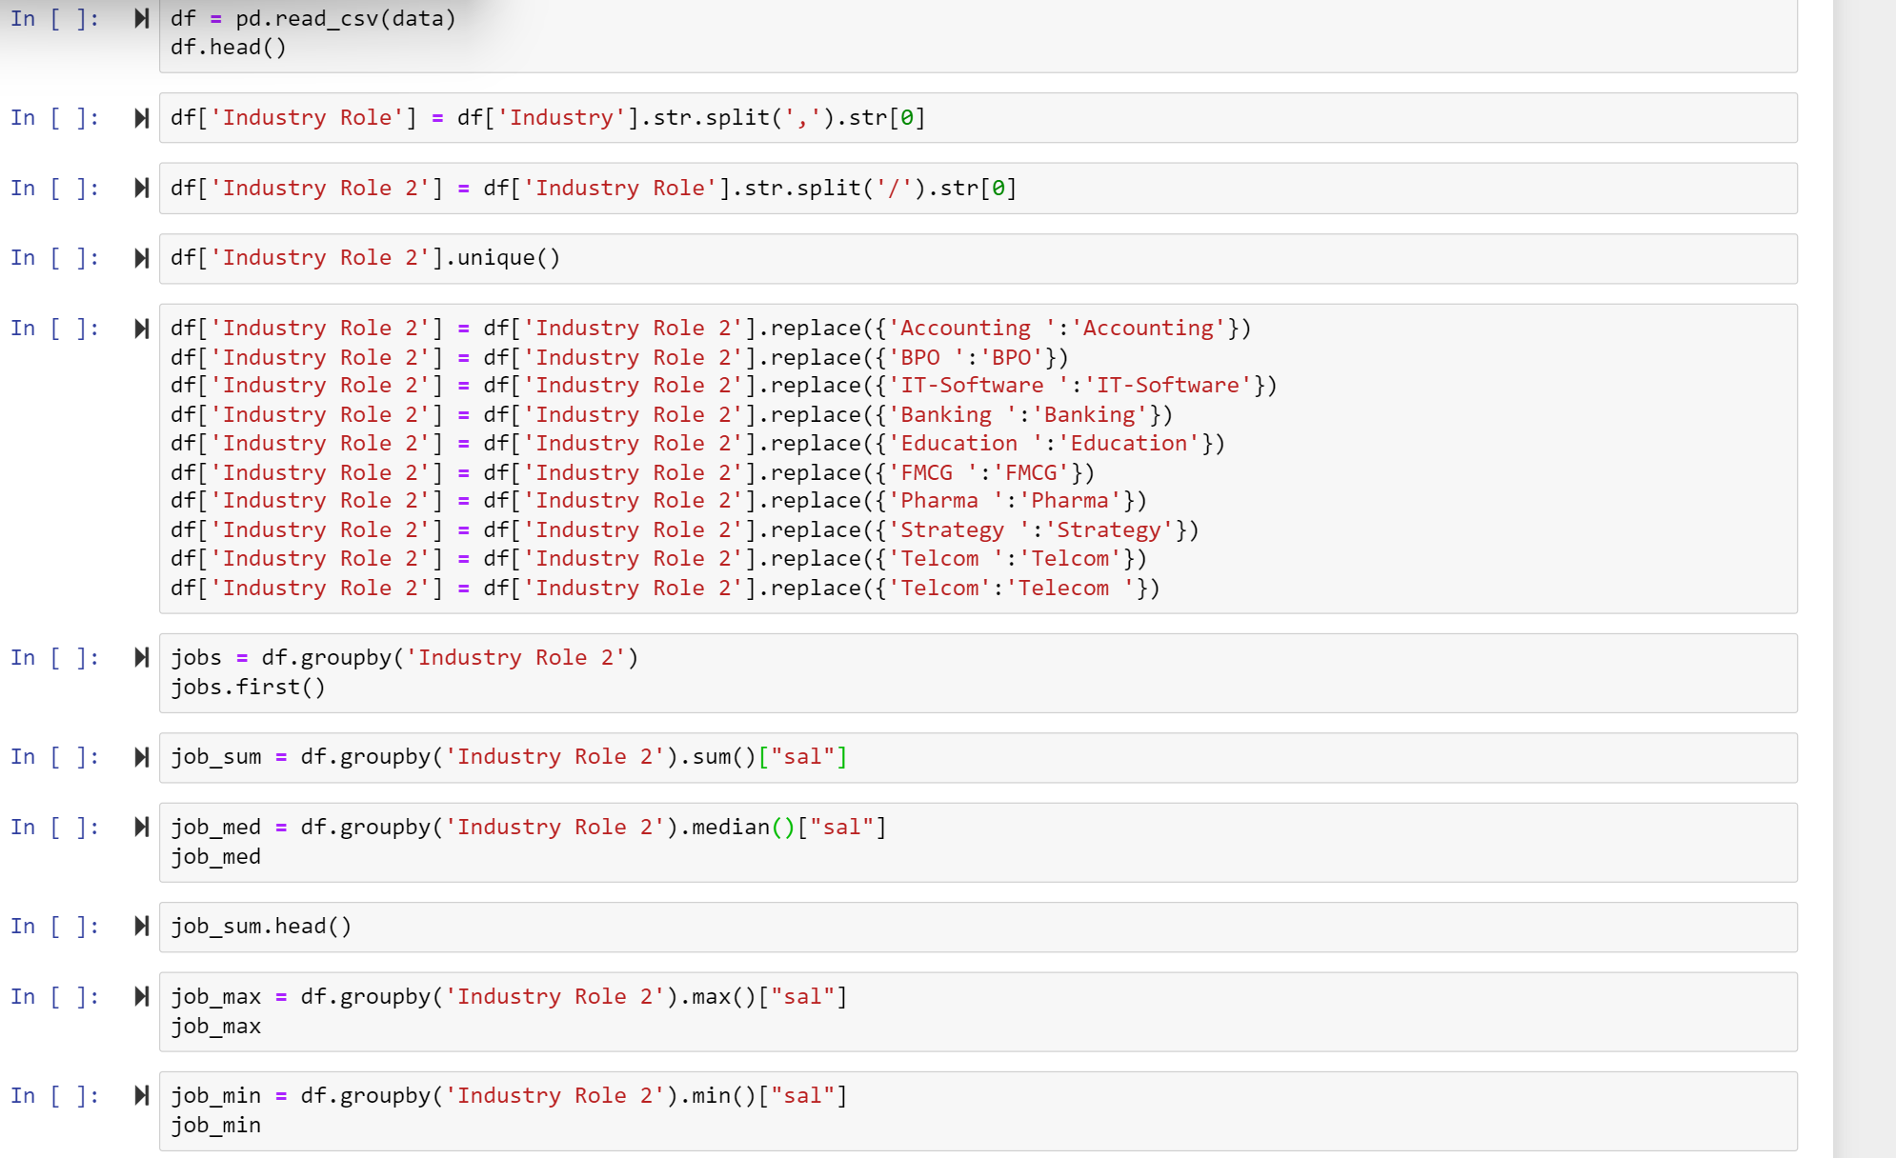

Slide 22
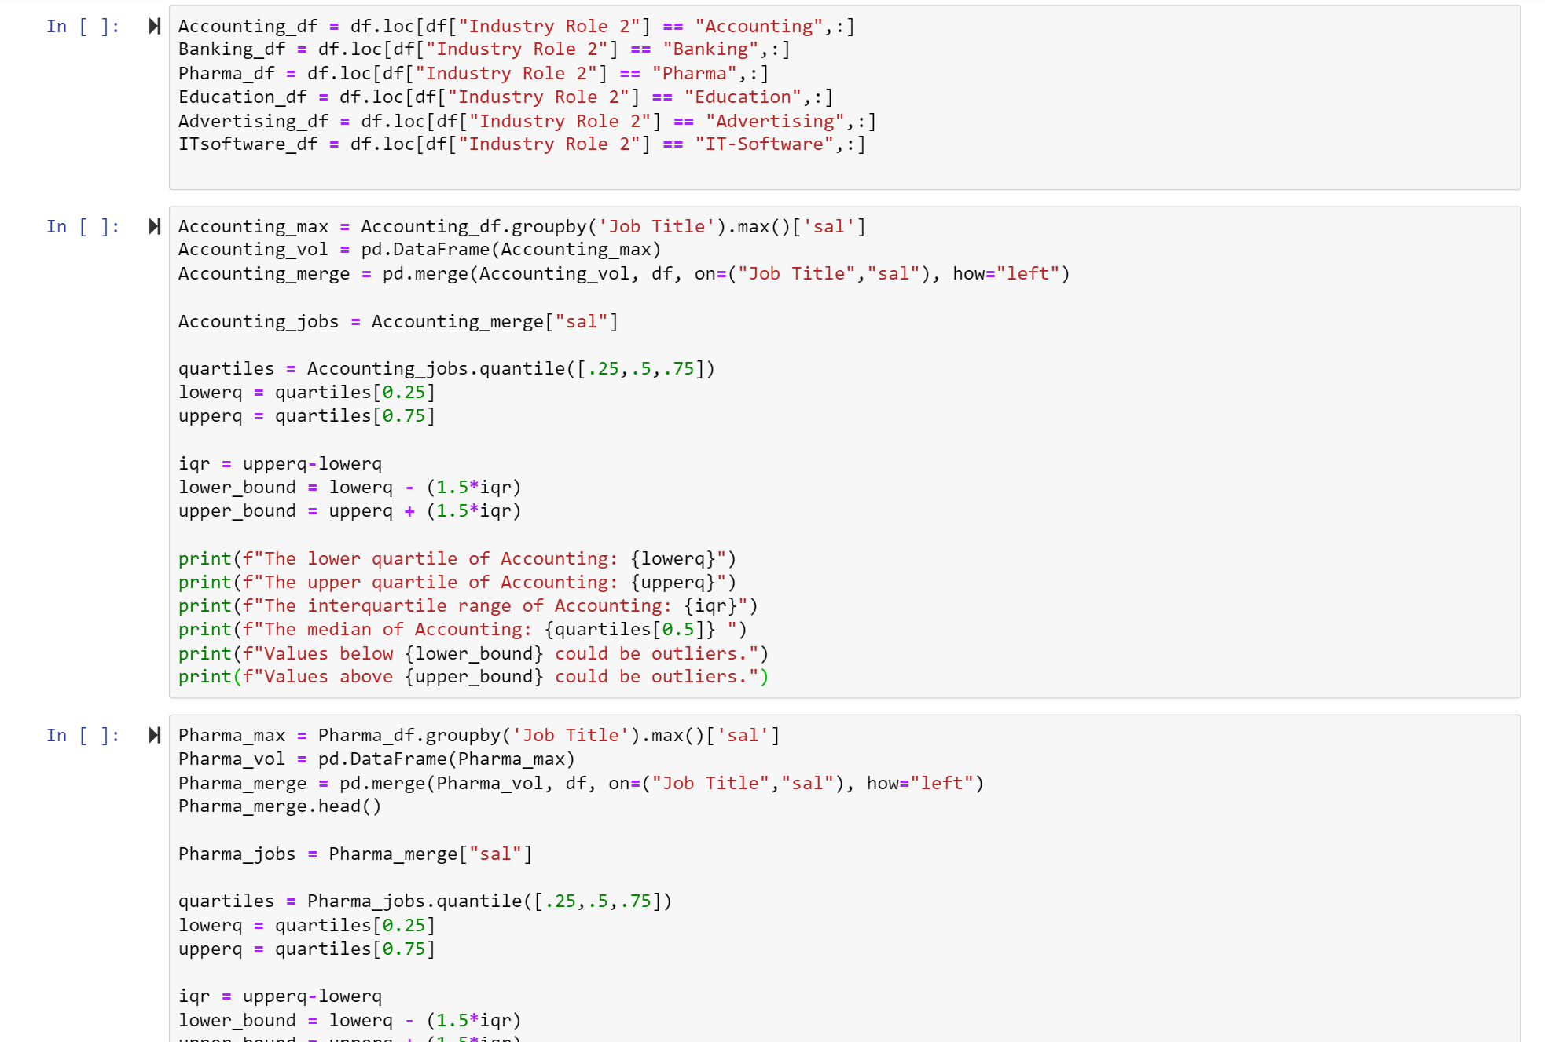

Slide 23
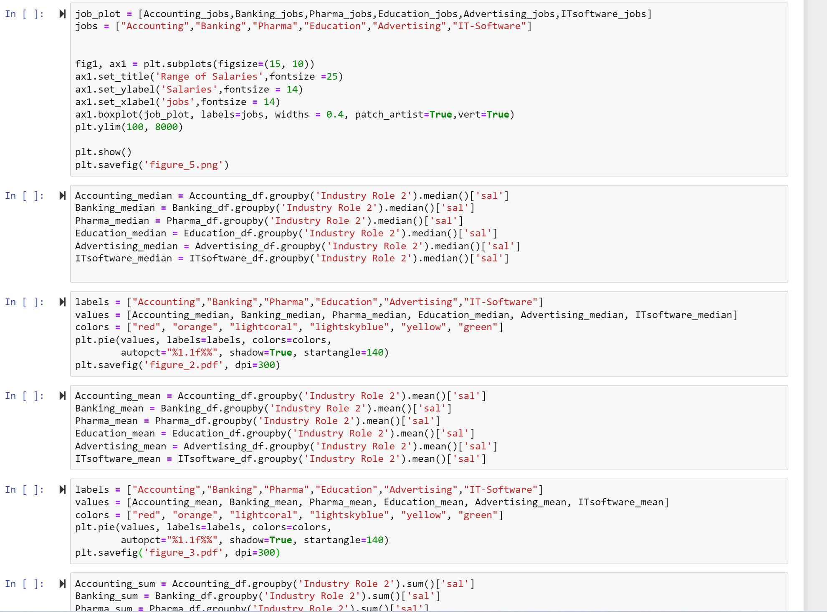

Slide 24

Where are all the jobs with the highest salaries in India?
By: Chris

Slide 25
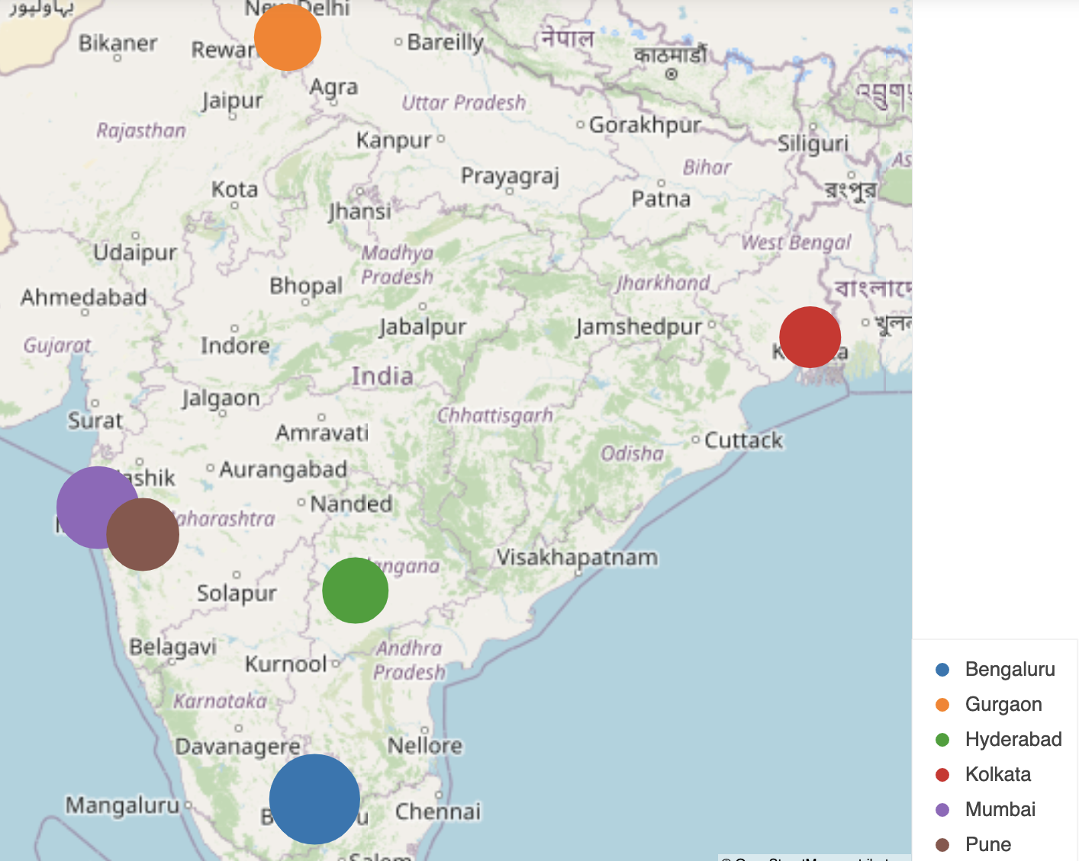
Top Location to search for employment
Top locations in India to look for jobs in order:
Bengaluru → 70
Mumbai → 58
Pune → 45
Gurgaon → 38
Hyderabad → 37
Kolkata → 32

Slide 26
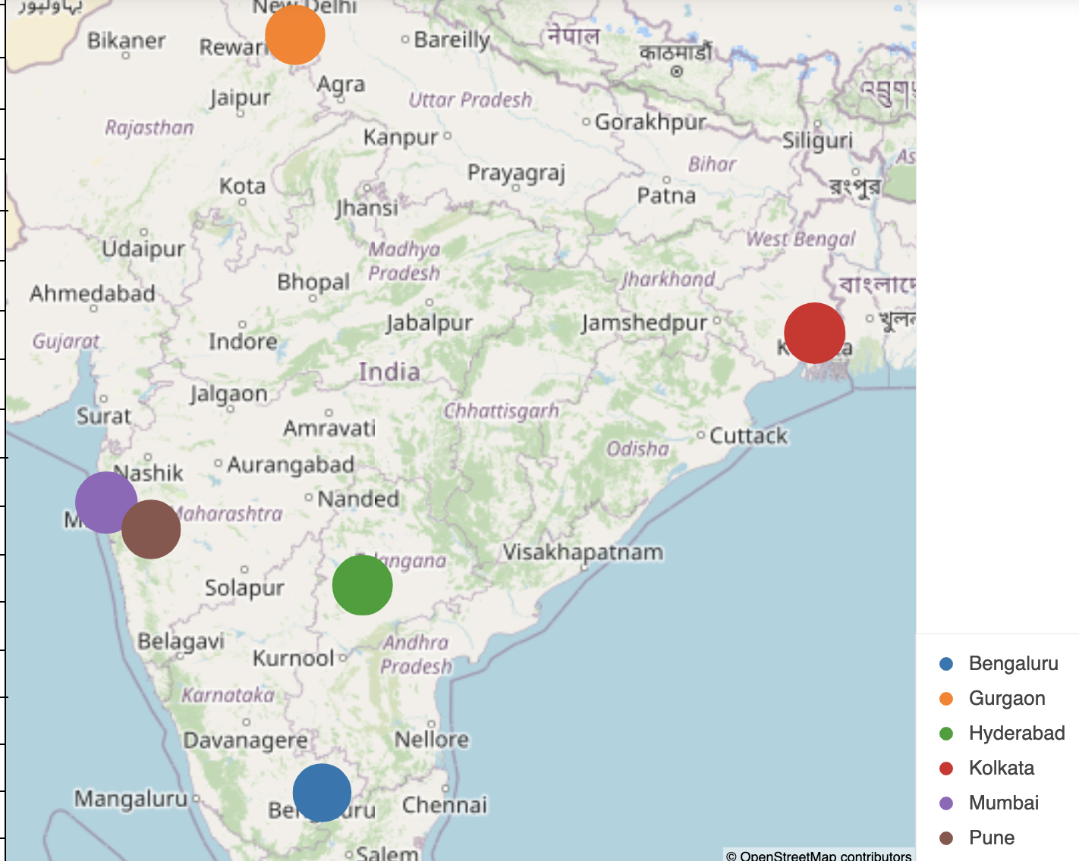
Average Salary by Location
Average Salary:
Mumbai → $4,476
Kolkata → $4,352
Hyderabad → $4,243
Gurgaon → $4,153
Pune → $4,053
Bengaluru → $3,969

Slide 27
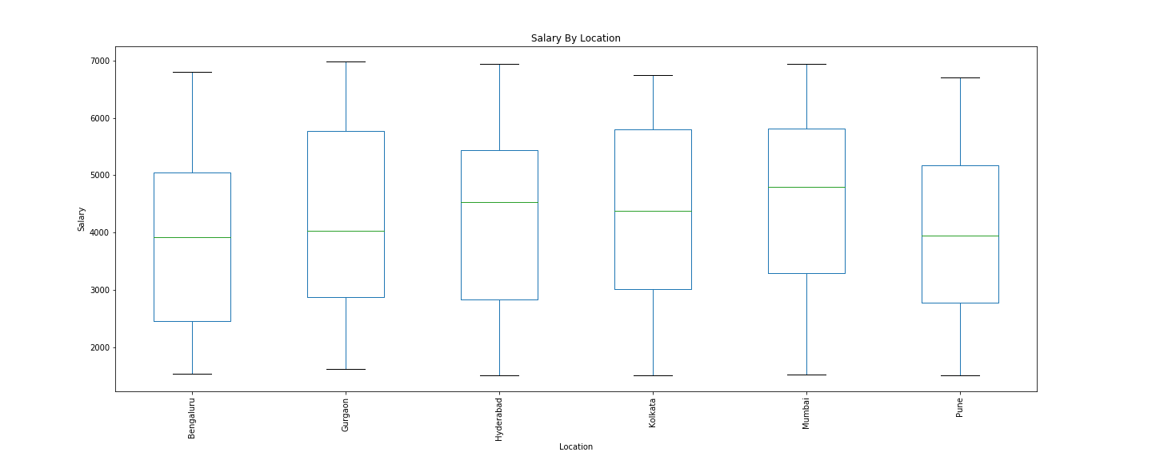
Salary Range By Location

Slide 28
Analysis Results
Mumbai has the most opportunity to find a job
Total of available positions 58
Mumbai has the highest top end range of salaried positions
Minimum Salary of $3,500
Maximum Salary of $5,900

Slide 29
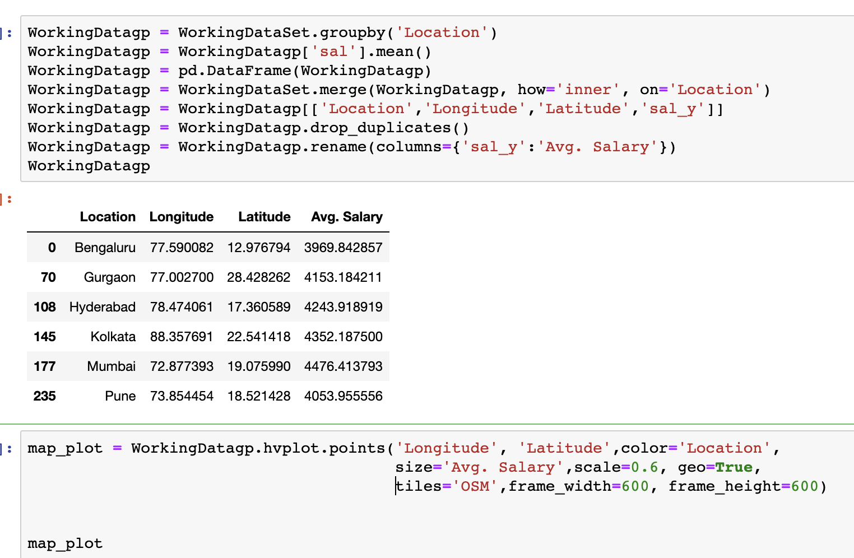
Map Visualization Setup Avg. Salary
Created two data frames
Average Salary grouped by location
Original Data frame
Merged data frame
Removed duplicates

Slide 30
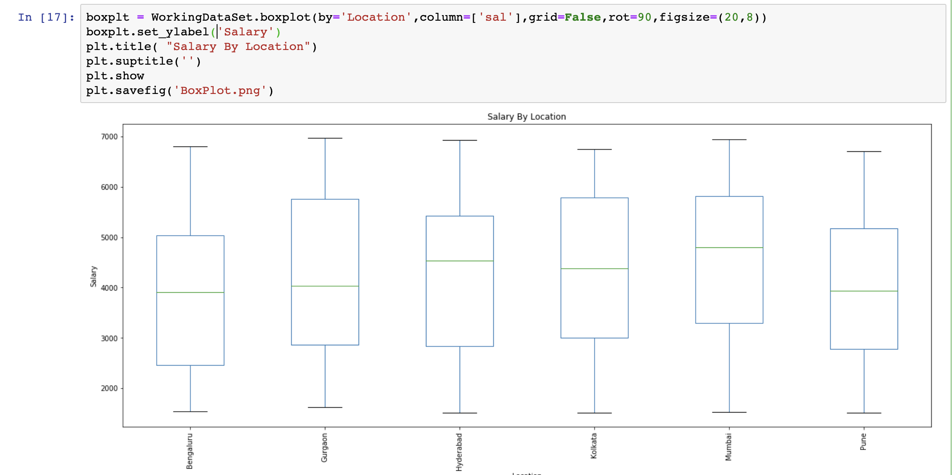
Pandas Boxplot
Created data frame
Group by Location
Assigned Location in the “by=“, and Salary to the “columns=“
Created a title
Created Y label

